Slide 1
College Council
November 3, 2022

Slide 2
Reporting Committees

Slide 3
Facilities – Cody Pauxtis
DA2 M&O: Constance Shropshire Starts 7 November
Grounds worker 1 Position was sent backout for another round of applications.
Next Meeting 16 November

Slide 4
Safety & Security – Kevin King
Updates
Internal Cerro Coso Employees Starts Monday.
Next Safety Committee meeting Nov 16

Slide 5
Technology Resource Team (TRT) – Mike Campbell
Next meeting Nov 16 2:30PM

Slide 6
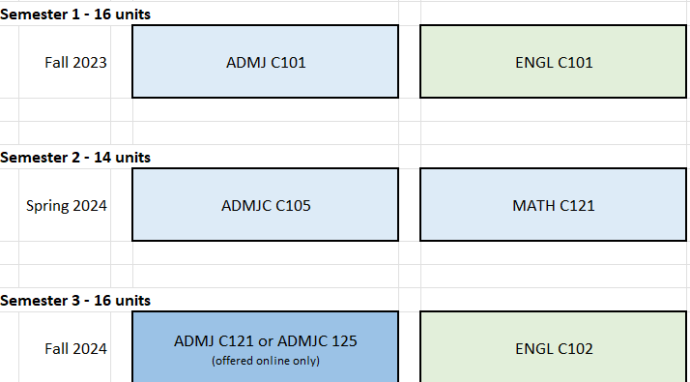
Student Equity and Achievement Committee (SEAC)– Heather Ostash
Finalizing the Equity Plan for submission
Two primary priorities related to Equity and Guided Pathways-
1. Pathways
2. Case-management/Student Success team approaches to Counseling/Advising and serving students

Slide 7
Incarcerated Students Education Program – Corey Marvin
Adding and Removing Programs – the committee received a presentation from Melissa Bowen on two proposed new programs at the prisons--Social Work and Human Services, and Addiction Studies. Both programs were well received by the committee. It also discussed steps for removing a program and tasked a working subgroup to develop criteria for identifying programs for discontinuance. Where would these criteria be captured? The committee discussed the need to develop an ISEP program handbook—very likely by expanding and updating the current ISEP faculty handbook—as a place to write these things down.
Update on Operational Items – the committee discussed in-person registration for spring semester, the need to distinguish EW and Withdrawal Exception processes and documentation, adjunct hiring needs for the spring, desired changes in adjunct hiring practices in board policy, and the results of the October professional development event (very successful!)
Textbook adoptions – the committee discussed the historical and business reasons the ISEP program prefers open educational resources and why it has made exceptions and on what basis. It tasked a second workgroup with developing language for the ISEP Handbook.

Slide 8
Constituency Reports

Slide 9
Associated Committees

Slide 10
Budget Development – Chad Houck
SMSR funding for this year is more than last year
HVAC maintenance and efficiency upgrades
Power vulnerabilities
Water conservation
Signage updates
Budgeting
1st level requests are mostly submitted through Axiom
We are beginning our review of the rubric to used
HEERF requests
Several requests were approved
There is still a little more for requests
Next meeting is November 30

Slide 11
District Wide Budget Development Committee – Chad Houck
Have not met since last meeting.
Next meeting is not yet scheduled.

Slide 12
Institutional Effectiveness Committee (IEC) – Corey Marvin
Have not met. Next meeting Thursday, December 1

Slide 13
Professional Development Committee – Corey Marvin
Last meeting, Tuesday, October 11:
Report out on the 2022 Fall Flex days
Faculty Training for Online Teaching – the committee discussed the current guidelines for determining when a faculty member is prepared to teach in online (taken Suzie's online training class, taken a comparable course elsewhere, already taught online elsewhere, or no prior preparation but will be mentored by a member of the department). Discussion ensued about the level of requirement for being prepared (it is required in regulation) and who decides if prior training is sufficient? The committee believes faculty would know this best and referred the matter to the faculty flex committee and faculty senate as a whole for discussion on this matter.
All-Staff PD Survey – the committee looked at Palomar's all-staff survey and liked it, and proposed that Andrew work with Jaclyn to render this into survey software and plan for distribution in the March/April timeframe.
Next meeting Tuesday, November 8

Slide 14
Accreditation – Corey Marvin
Have not met. Next meeting not yet scheduled.

Slide 15
The End

